Slide 1
Presentation | 2023-5-30
Paper Reading: Modeling Gene Regulatory
Networks Using Neural Network Architectures
Yuzhe Wang¹, Shan Liu²
¹ Peking University
² Beijing Computational Science Research Center

Slide 2
Outline
Background and Motivation
Single-cell RNA Sequencing
Single-cell Computational Tasks
Overview of DeepSEM
Methods
Variational Autoencoder (VAE)
Structural Equation Model (SEM)
DeepSEM: Framework and Implementation
Model Performance
GRN Inference
Single-cell Clustering and Embedding
scRNA-seq Data Simulation

Slide 3
Outline
Background and Motivation
Single-cell RNA Sequencing
Single-cell Computational Tasks
Overview of DeepSEM
Methods
Variational Autoencoder (VAE)
Structural Equation Model (SEM)
DeepSEM: Framework and Implementation
Model Performance
GRN Inference
Single-cell Clustering and Embedding
scRNA-seq Data Simulation

Slide 4
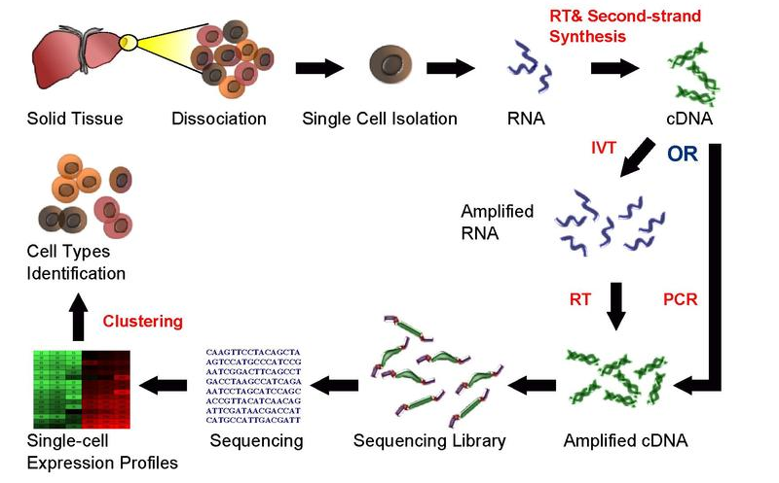
Single-cell RNA Sequencing
Single-cell ENA Sequencing (scRNA-seq)
Experimental noise introduces biases in the gene expression
Deep learning benefits single-cell transcriptome data analysis
https://en.wikipedia.org/wiki/Single-cell_sequencing

Slide 5
Single-cell Computational Tasks
GRN Inference
Methods relying on side measurements
single-cell chromatin accessibility or TF binding motifs
Introduce additional noise
Methods solely based on scRNA-seq data
Focus on the co-expression networks instead of decoding the casual relationships among TFs and their corresponding target genes
Methods that incorporate linear models or tree-based models
Hard to directly generalize these to more comprehensive nonlinear frameworks and benefit from the computational power that the deep learning model brought to us

Slide 6
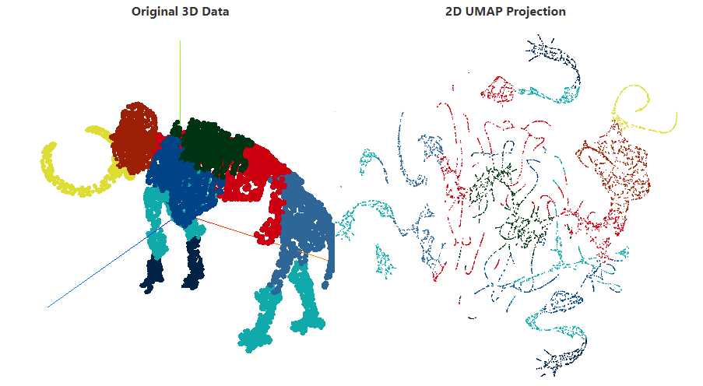
Single-cell Computational Tasks
scRNA-seq Data Visualization
Uniform Manifold Approximation Projection (UMAP)
The data is uniformly distributed on Riemannian manifold
The Riemannian metric is locally (approximately) constant
The manifold is locally connected

Slide 7
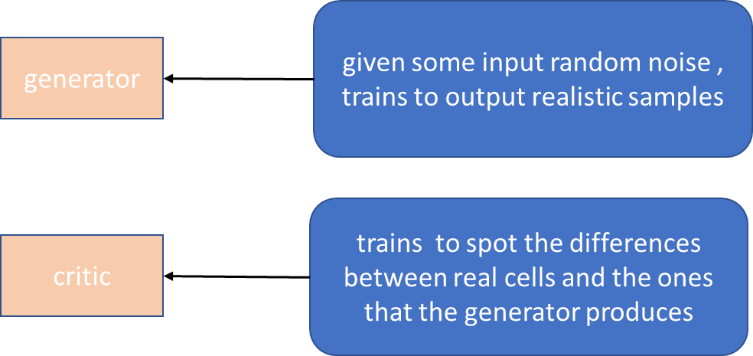
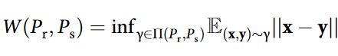
Single-cell Computational Tasks
scRNA-seq Data Simulation
Single-cell generative adversarial neural networks (scGAN)
Conditional single-cell generative adversarial neural networks (cscGAN)
Bahrami, M., Maitra, M., Nagy, C., Turecki, G., Rabiee, H. R., & Li, Y. (2021). Deep feature extraction of single-cell transcriptomes by generative adversarial network. Bioinformatics, 37(10), 1345-1351.
Marouf, M., Machart, P., Bansal, V., Kilian, C., Magruder, D. S., Krebs, C. F., & Bonn, S. (2020). Realistic in silico generation and augmentation of single-cell RNA-seq data using generative adversarial networks. Nature communications, 11(1), 166.

Slide 8
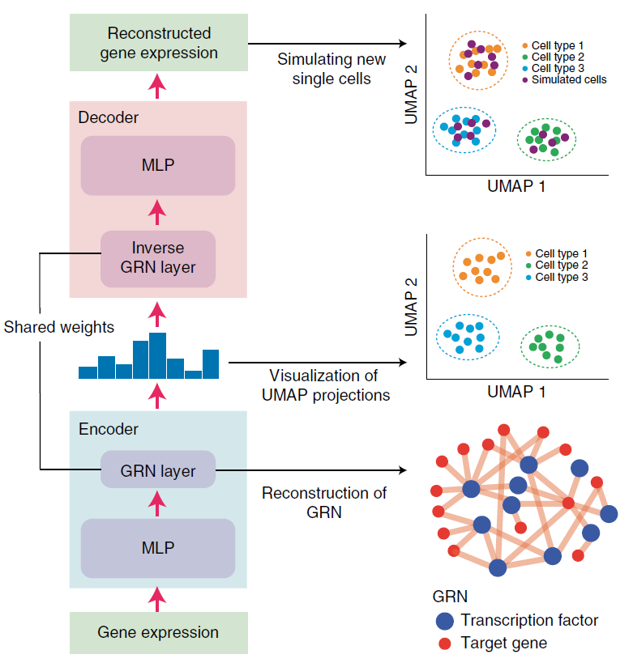
Overview of DeepSEM
DeepSEM: β-VAE + SEM
Shu, H., Zhou, J., Lian, Q., Li, H., Zhao, D., Zeng, J., & Ma, J. (2021). Modeling gene regulatory networks using neural network architectures. Nature Computational Science, 1(7), 491-501.

Slide 9
Outline
Background and Motivation
Single-cell RNA Sequencing
Single-cell Computational Tasks
Overview of DeepSEM
Methods
Variational Autoencoder (VAE)
Structural Equation Model (SEM)
DeepSEM: Framework and Implementation
Model Performance
GRN Inference
Single-cell Clustering and Embedding
scRNA-seq Data Simulation

Slide 10
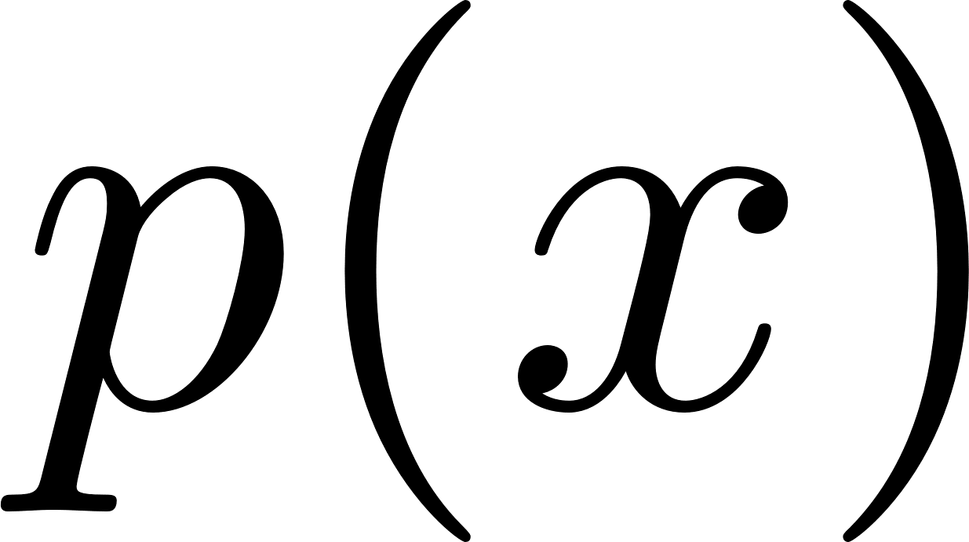

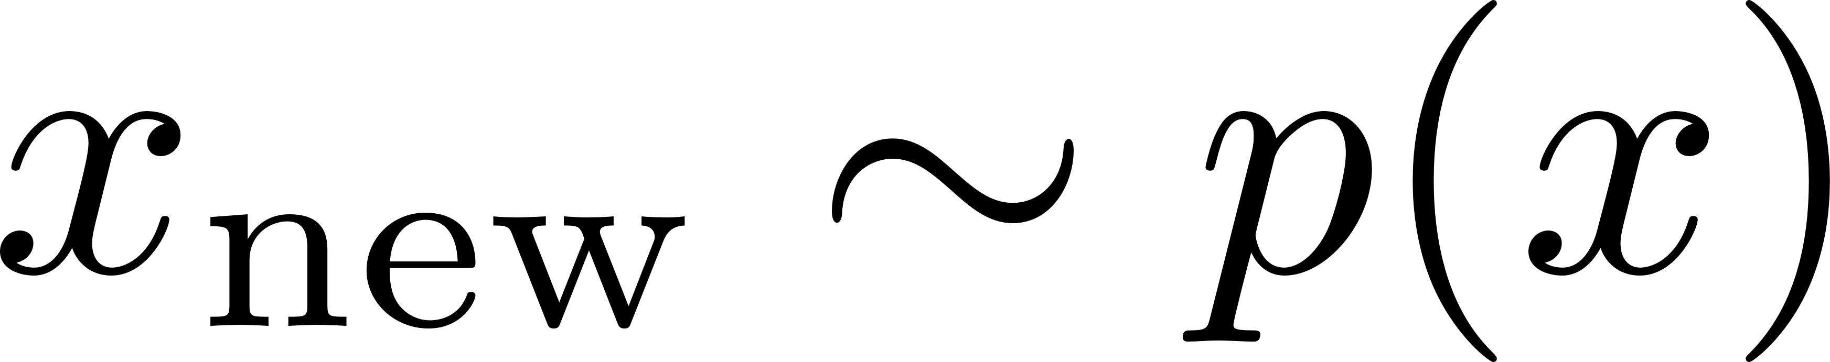

Variational Autoencoder (VAE)
Generative Models
Goal: Learn a probability distribution over such that
Generation: If we sample , should look like a real image
Density Estimation: should be high if looks like a real image, and low otherwise (anomaly detection)
Unsupervised Representation Learning: We should be able to learn high level features of these images
Key questions: how to construct and learn ?

Slide 11



Variational Autoencoder (VAE)
Learning as Density Estimation
Goal: construct as close as possible to (where we assume the dataset come from)

Slide 12
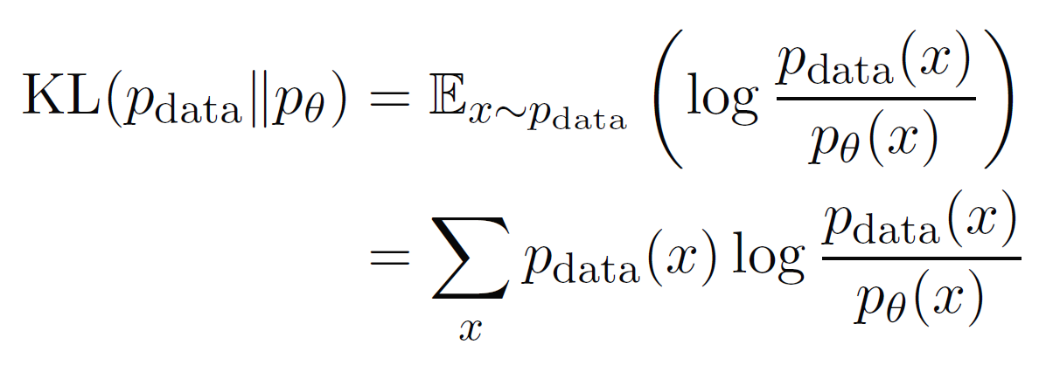
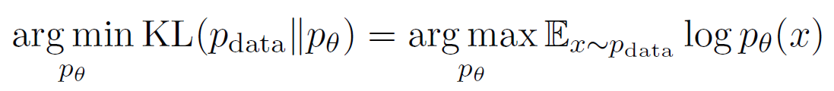
Variational Autoencoder (VAE)
Learning as Density Estimation
Goal: construct as close as possible to (where we assume the dataset come from)
Measurement of closeness: KL-divergence
Minimizing KL-divergence is equivalent to maximizing the expected log-likelihood

Slide 13

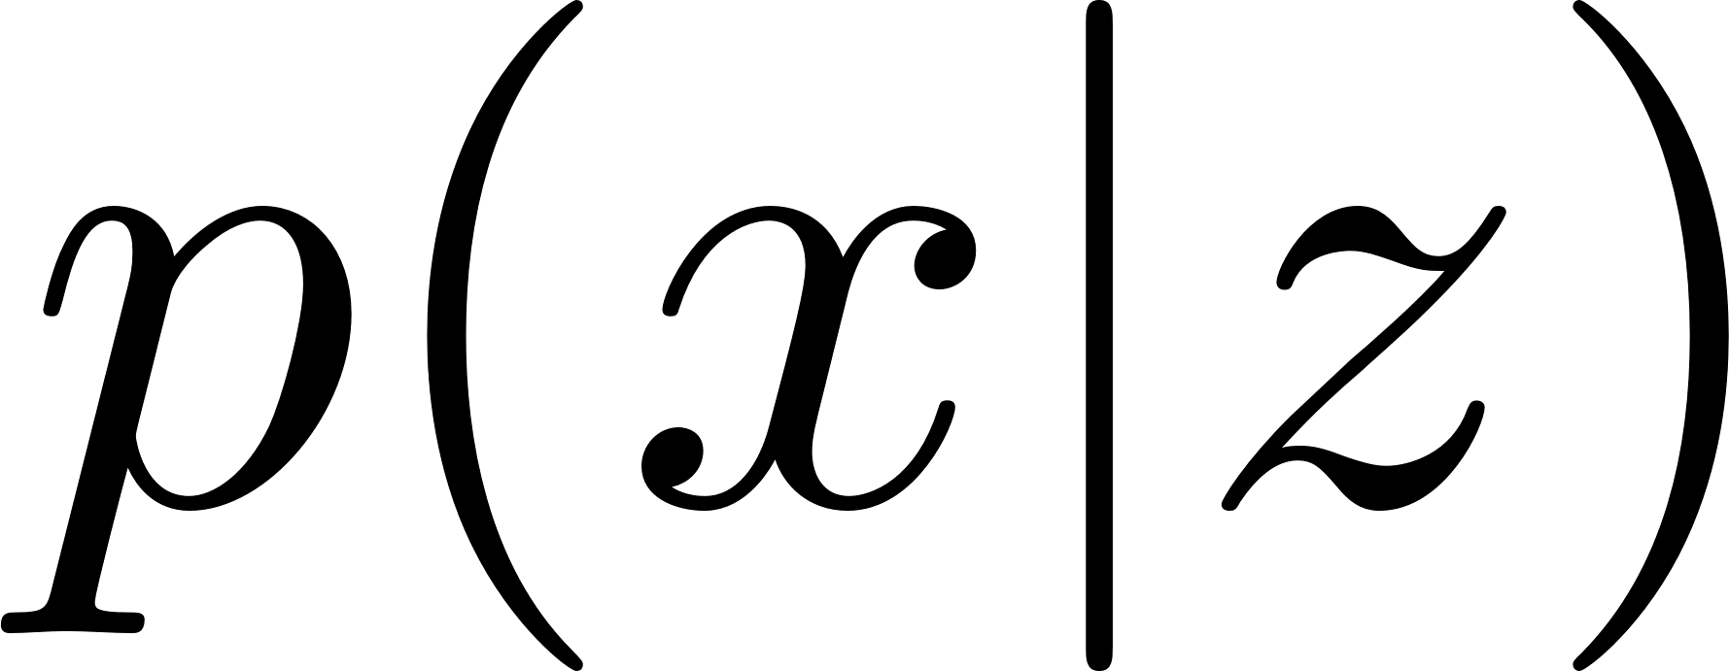
Variational Autoencoder (VAE)
Latent Variable Models
Latent variables corresponds to high-level features, could be much simpler that if chosen properly
Deep Latent Variable Models
Learn via deep neural networks

Slide 14
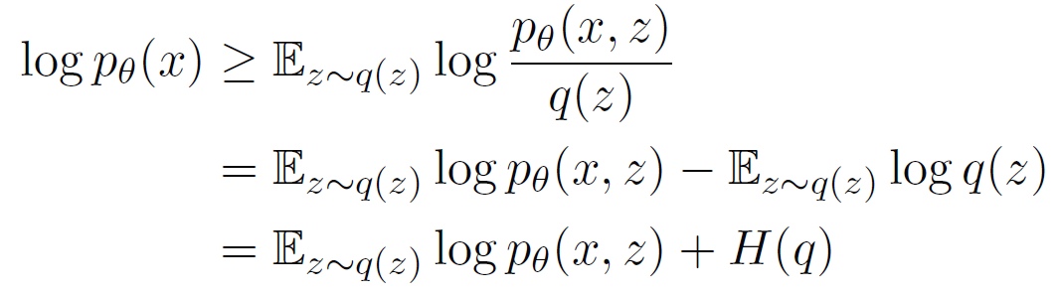

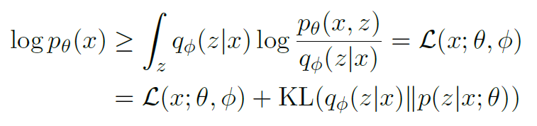
Variational Autoencoder (VAE)
Variational Inference for Latent Variable Models
Evidence Lower Bound (ELBO)
Maximize the expected log-likelihood by maximizing ELBO
Notes:
Jensen不等式
Variational来自variational family q_Φ

Slide 15
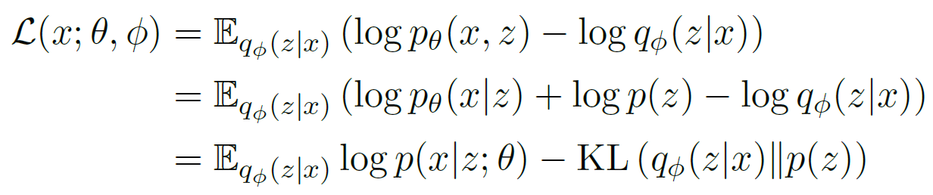
Variational Autoencoder (VAE)
Variational Autoencoders
Kingma, D. P., & Welling, M. (2013). Auto-encoding variational bayes. arXiv preprint arXiv:1312.6114.
Notes:
既有推断inference能力 又有生成generative能力

Slide 16
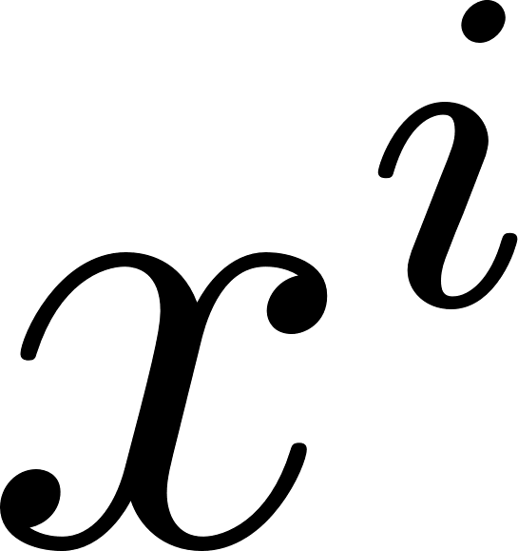

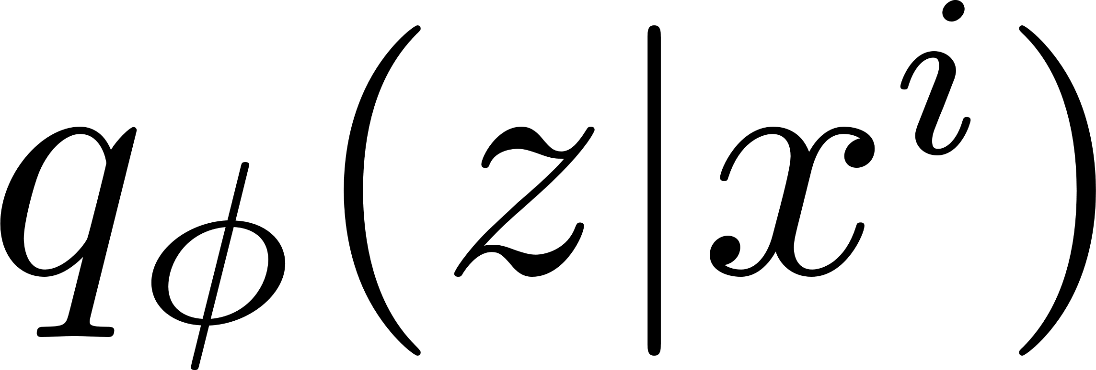

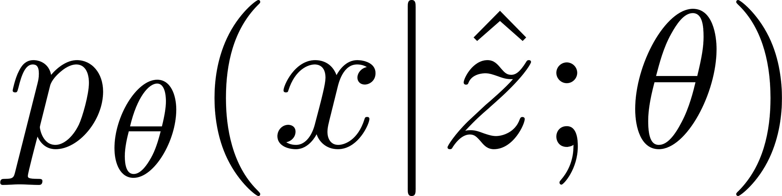
Variational Autoencoder (VAE)
Intuition of Variational Autoencoders
Take a data point
Encoder maps to by sampling from
Decoder reconstruct by sampling from
Kingma, D. P., & Welling, M. (2013). Auto-encoding variational bayes. arXiv preprint arXiv:1312.6114.

Slide 17
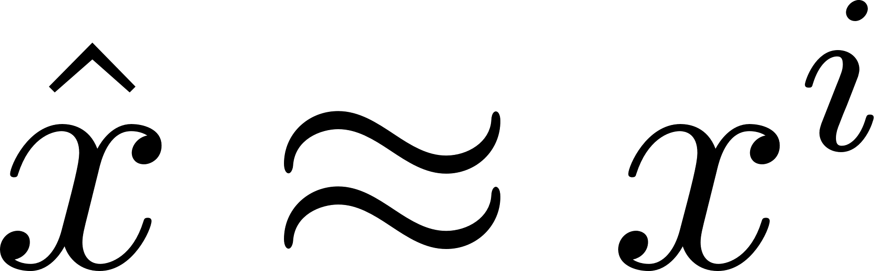
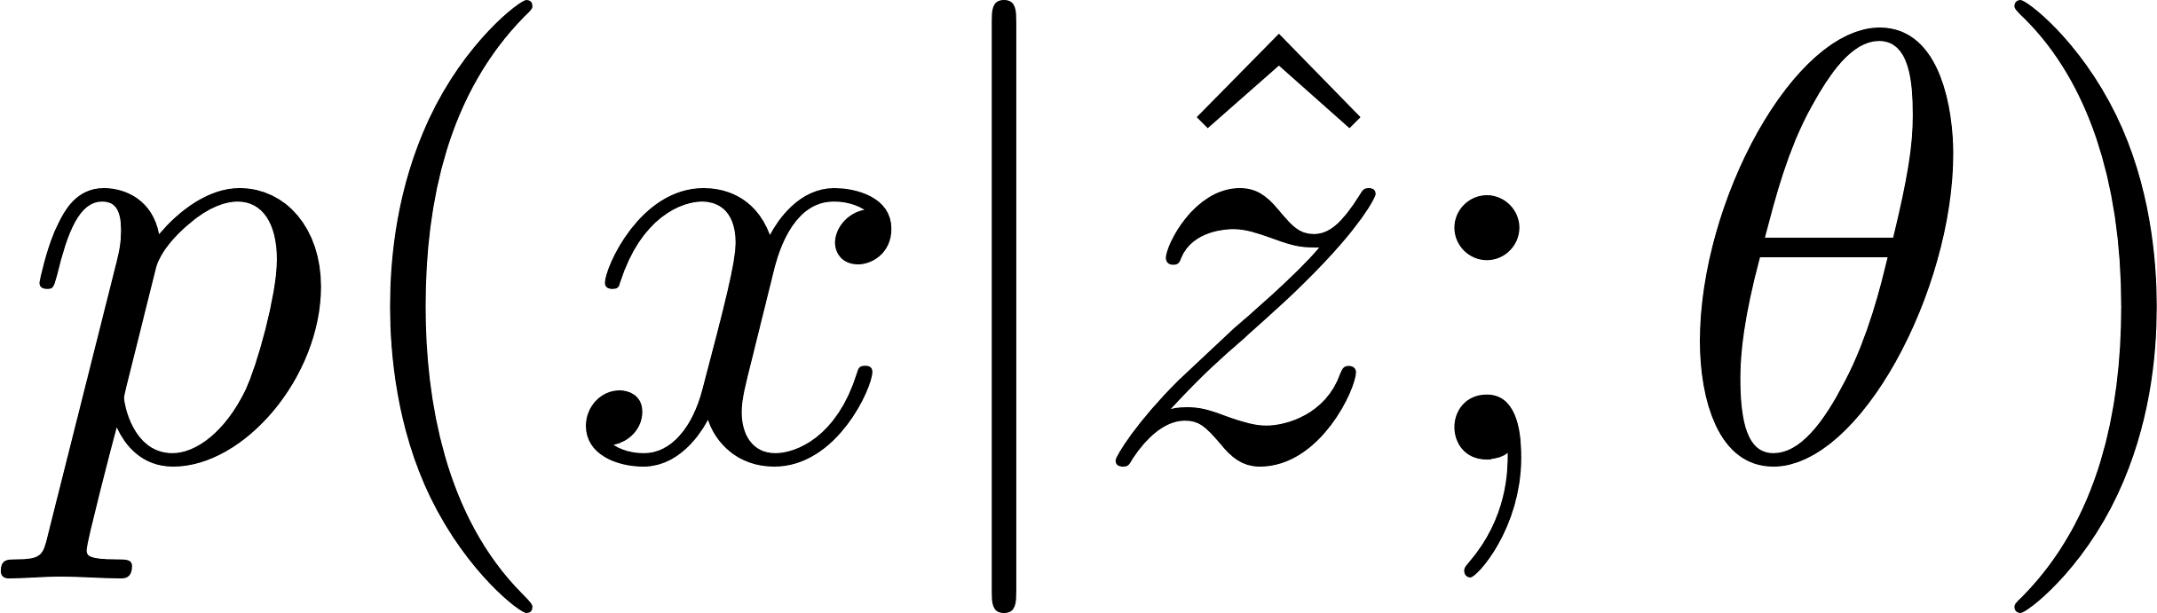
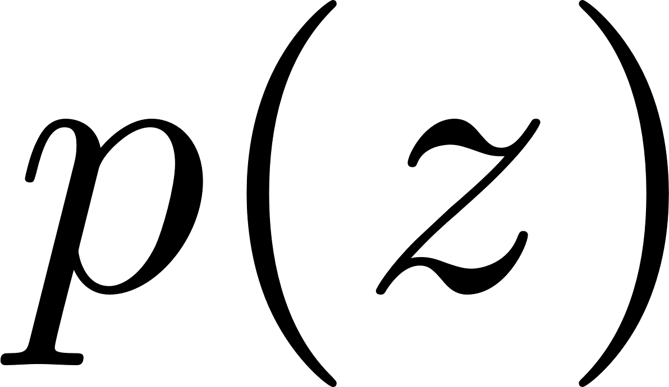
Variational Autoencoder (VAE)
Intuition of Variational Autoencoders
First term encourages ( likely under )
Second term encourages to be likely under the prior
Kingma, D. P., & Welling, M. (2013). Auto-encoding variational bayes. arXiv preprint arXiv:1312.6114.

Slide 18
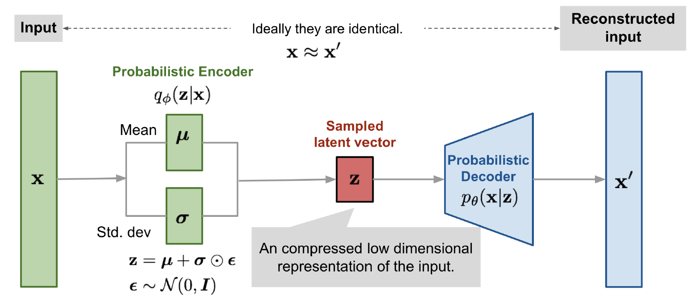
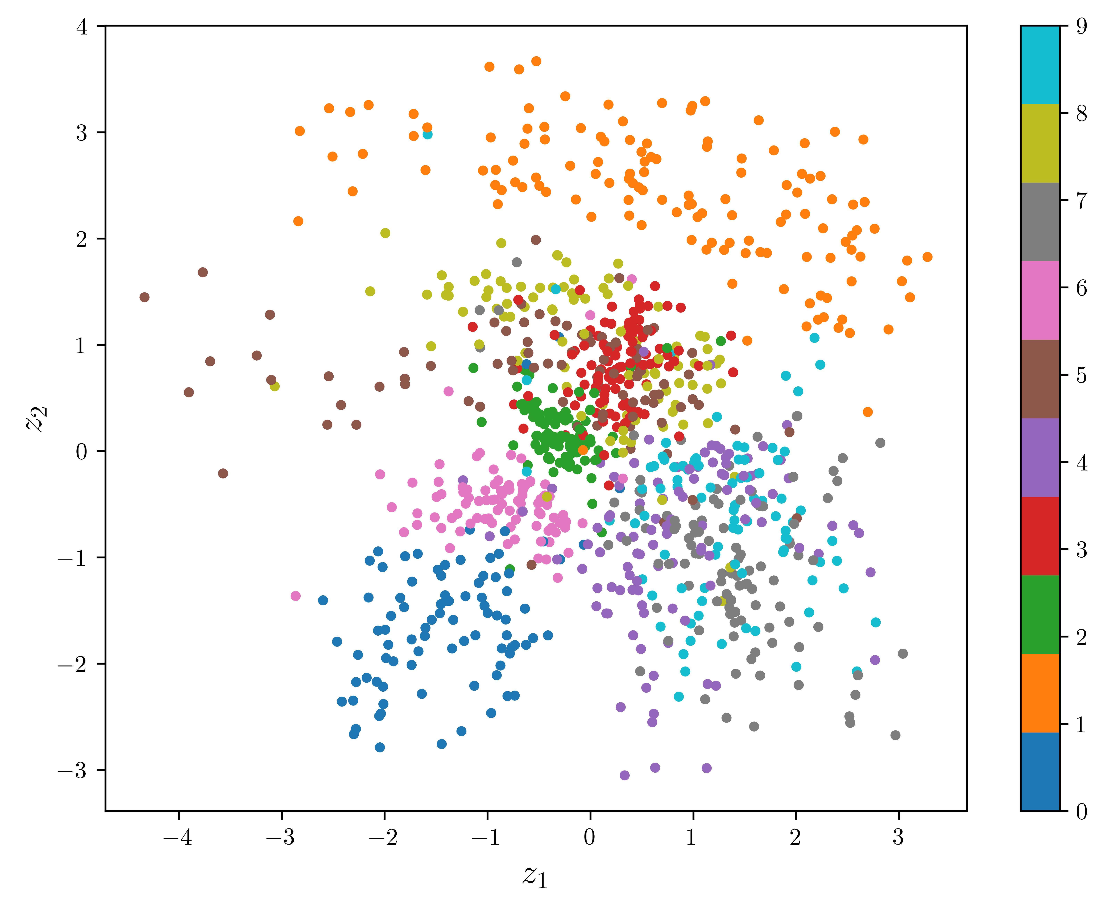
Variational Autoencoder (VAE)
Example: Inference and Generation of MNIST Dataset using VAE
Notes:
实际VAE分别用两个神经网络建模mean和std
Reparameterization trick

Slide 19


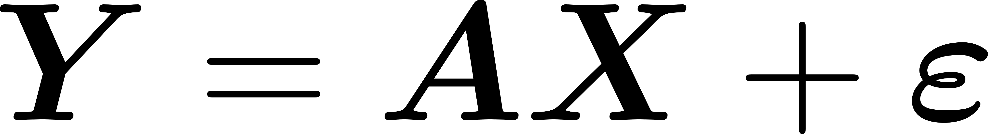

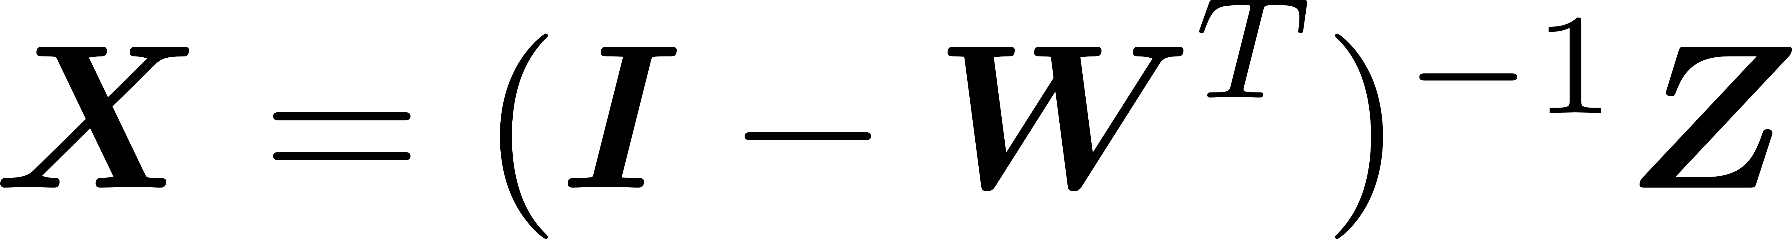
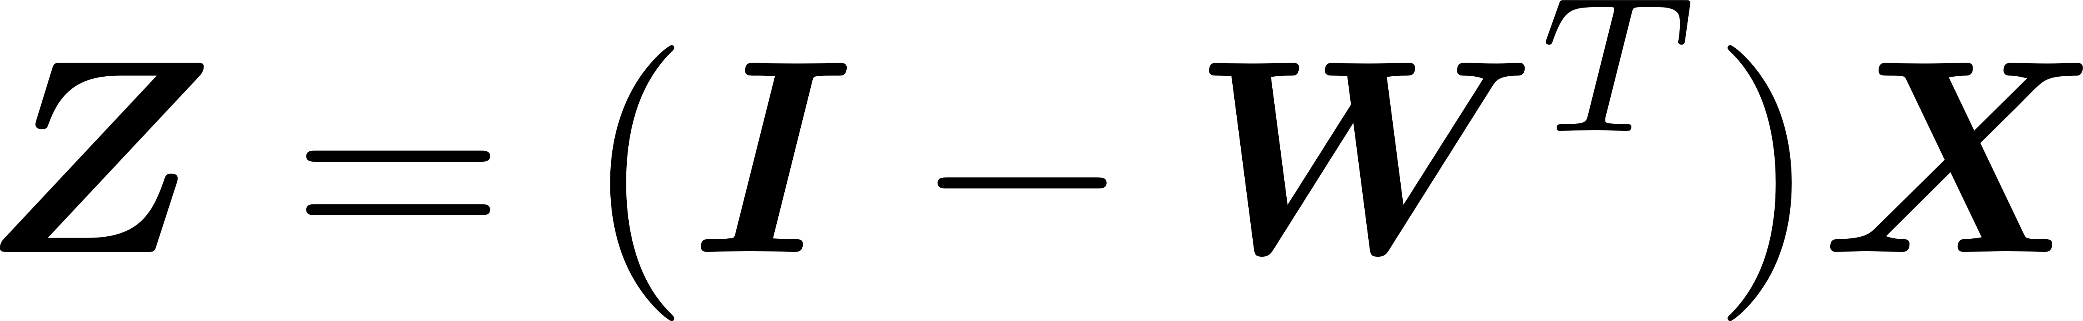

Structural Equation Model (SEM)
Structural Equation Model
Gaussian linear latent variable model
Linearity of the relations between the variables
Normality, Gaussian distribution for the residuals of the latent variables and the residuals of the observed variables
Linear measurement model: relate the latent variables to the observed variables
Linear structural model: relate the latent variables to each other (self-regression problem)
which gives
are noise matrices of multivariate Gaussian distribution
Bollen, K. A. (1989). Structural equations with latent variables (Vol. 210). John Wiley & Sons.
Notes:
残差

Slide 20
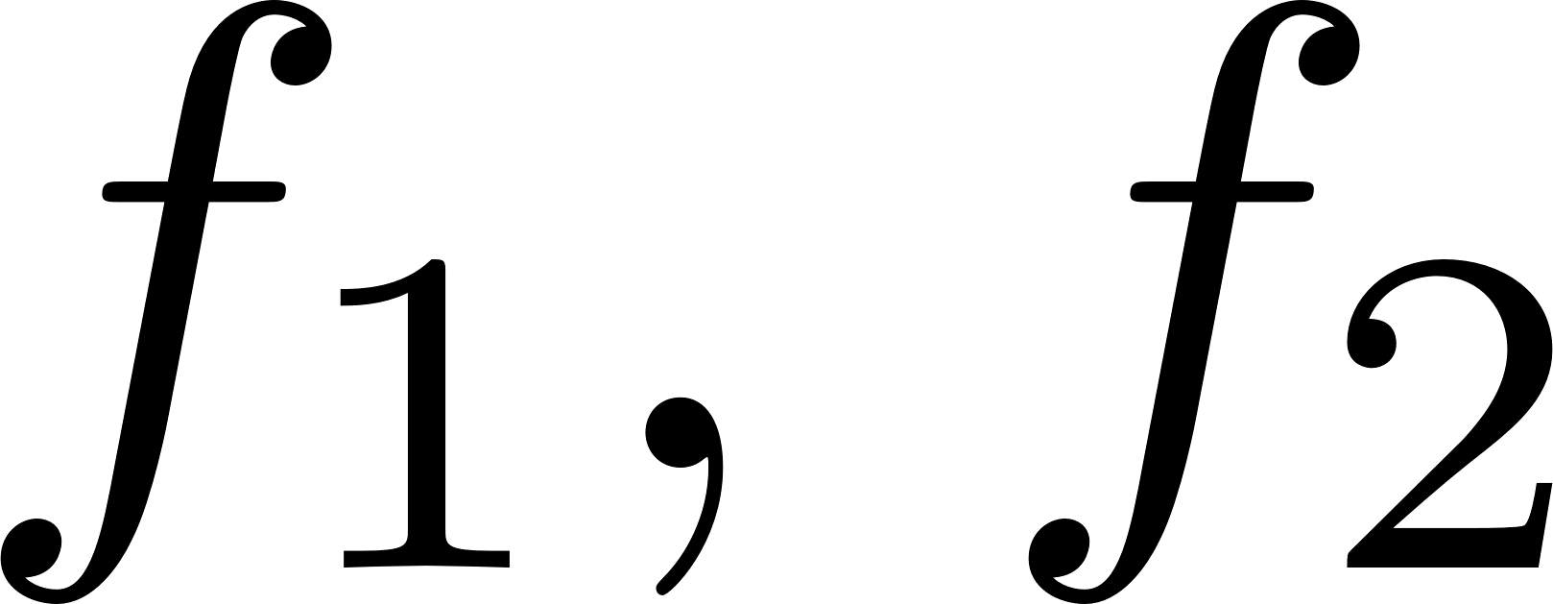
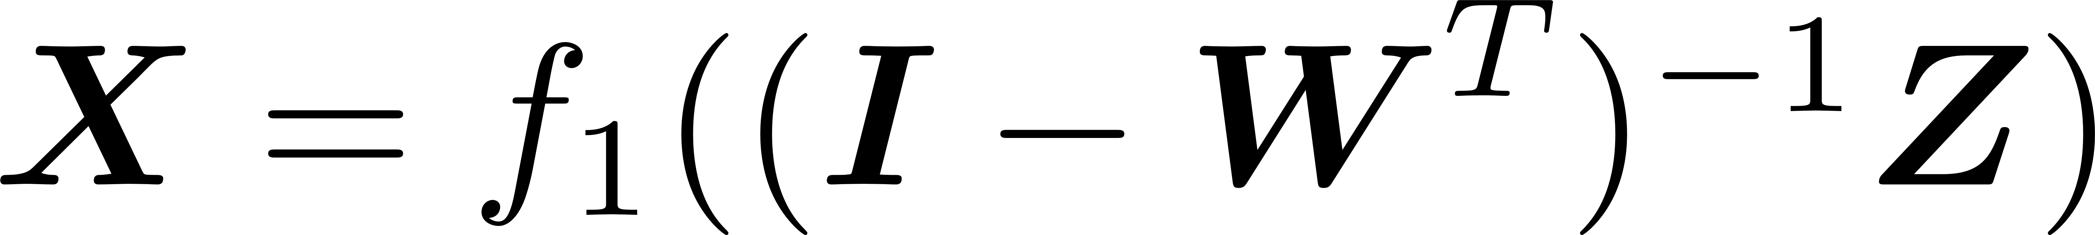
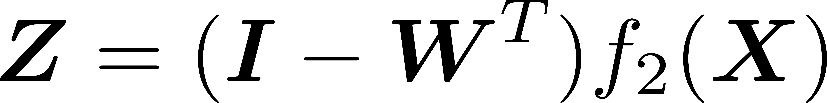
Structural Equation Model (SEM)
Deep Structural Equation Model
Gaussian linear latent variable model
Linearity of the relations between the variables
Normality, Gaussian distribution for the residuals of the latent variables and the residuals of the observed variables
Deep measurement model: relate the latent variables to the observed variables with deep neural networks (e.g. MLP)
Deep structural model: relate the latent variables to each other (self-regression problem)
multilayer neural network
Yu, Y., Chen, J., Gao, T., & Yu, M. (2019, May). DAG-GNN: DAG structure learning with graph neural networks. In International Conference on Machine Learning (pp. 7154-7163). PMLR.
Notes:
残差

Slide 21
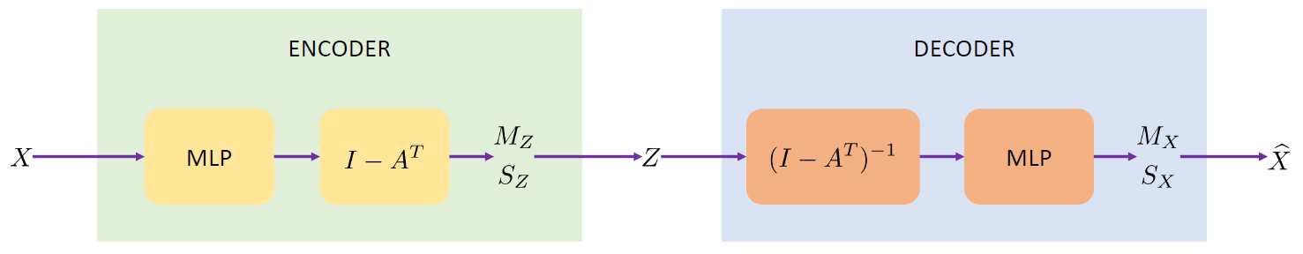
Structural Equation Model (SEM)
Deep Structural Equation Model → VAE
Gaussian linear latent variable model
Linearity of the relations between the variables
Normality, Gaussian distribution for the residuals of the latent variables and the residuals of the observed variables
Deep measurement model: relate the latent variables to the observed variables with deep neural networks (e.g. MLP)
Deep structural model: relate the latent variables to each other (self-regression problem)
multilayer neural network as Decoder and Encoder
Yu, Y., Chen, J., Gao, T., & Yu, M. (2019, May). DAG-GNN: DAG structure learning with graph neural networks. In International Conference on Machine Learning (pp. 7154-7163). PMLR.
Notes:
残差

Slide 22

DeepSEM: Framework and Implementation
Framework of DeepSEM
Shu, H., Zhou, J., Lian, Q., Li, H., Zhao, D., Zeng, J., & Ma, J. (2021). Modeling gene regulatory networks using neural network architectures. Nature Computational Science, 1(7), 491-501.

Slide 23
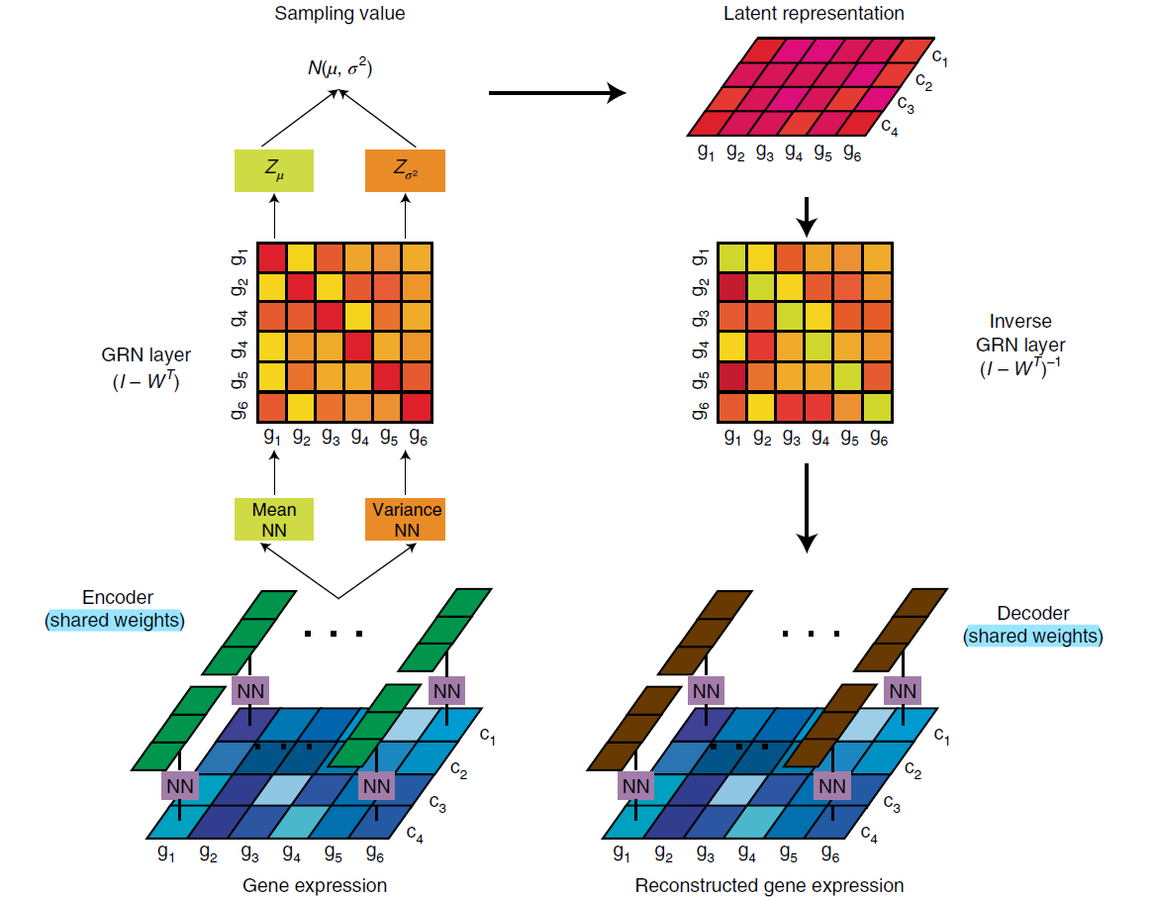
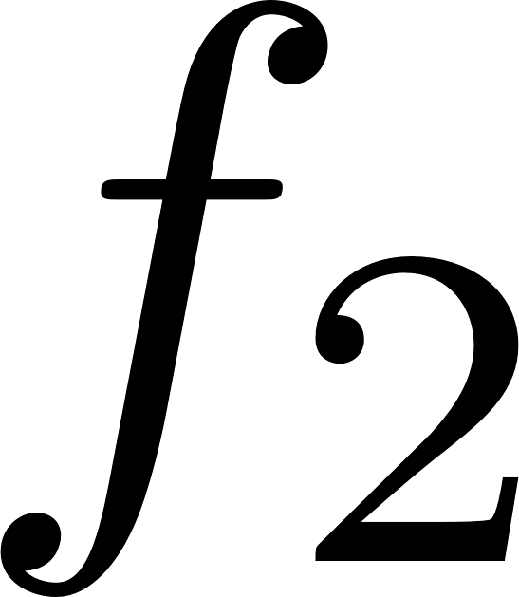
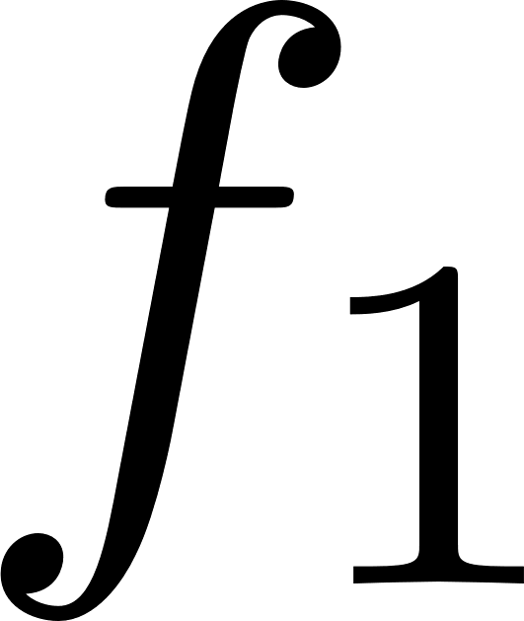
DeepSEM: Framework and Implementation
Framework of DeepSEM
Shu, H., Zhou, J., Lian, Q., Li, H., Zhao, D., Zeng, J., & Ma, J. (2021). Modeling gene regulatory networks using neural network architectures. Nature Computational Science, 1(7), 491-501.

Slide 24

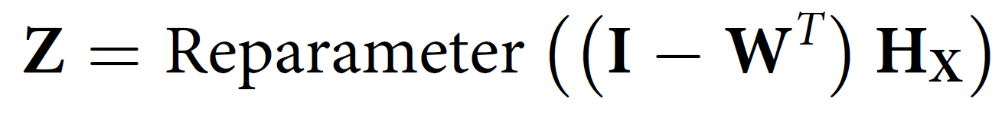
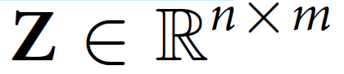
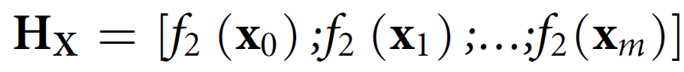
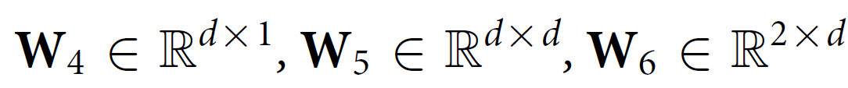
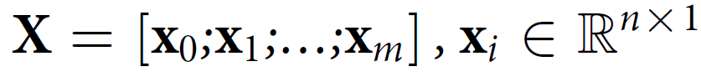
DeepSEM: Framework and Implementation
Framework of DeepSEM
Shu, H., Zhou, J., Lian, Q., Li, H., Zhao, D., Zeng, J., & Ma, J. (2021). Modeling gene regulatory networks using neural network architectures. Nature Computational Science, 1(7), 491-501.

Slide 25
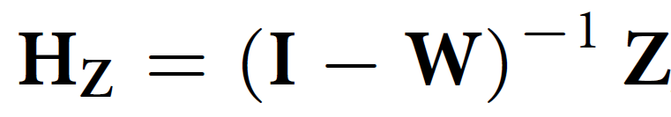
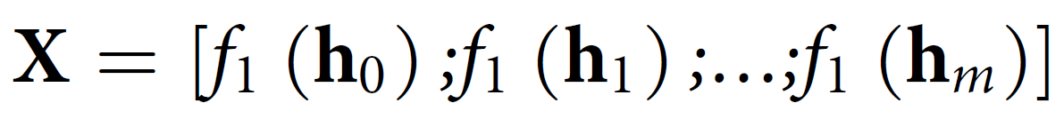
DeepSEM: Framework and Implementation
Framework of DeepSEM
Shu, H., Zhou, J., Lian, Q., Li, H., Zhao, D., Zeng, J., & Ma, J. (2021). Modeling gene regulatory networks using neural network architectures. Nature Computational Science, 1(7), 491-501.

Slide 26
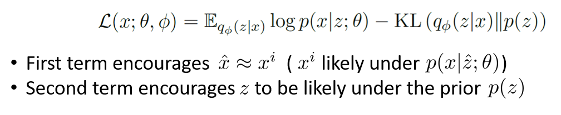

DeepSEM: Framework and Implementation
Implementation Details
β-VAE: a simple variant of vanilla VAE
Input: log-transformed scRNA-seq expression data (z-normalized)
Model training: RMSprop to avoid unstable behavior of Adam; optimize MLPs and alternately
Initialization: matrix diagonal of are set as zeros (no self-interactions)
Shu, H., Zhou, J., Lian, Q., Li, H., Zhao, D., Zeng, J., & Ma, J. (2021). Modeling gene regulatory networks using neural network architectures. Nature Computational Science, 1(7), 491-501.
Higgins, I., Matthey, L., Pal, A., Burgess, C., Glorot, X., Botvinick, M., ... & Lerchner, A. (2017, April). beta-vae: Learning basic visual concepts with a constrained variational framework. In International conference on learning representations.
Notes:
交替

Slide 27
Outline
Background and Motivation
Single-cell RNA Sequencing
Single-cell Computational Tasks
Overview of DeepSEM
Methods
Variational Autoencoder (VAE)
Structural Equation Model (SEM)
DeepSEM: Framework and Implementation
Model Performance
GRN Inference
Single-cell Clustering and Embedding
scRNA-seq Data Simulation

Slide 28

GRN Inference
Performance of GRN Inference
Shu, H., Zhou, J., Lian, Q., Li, H., Zhao, D., Zeng, J., & Ma, J. (2021). Modeling gene regulatory networks using neural network architectures. Nature Computational Science, 1(7), 491-501.

Slide 29
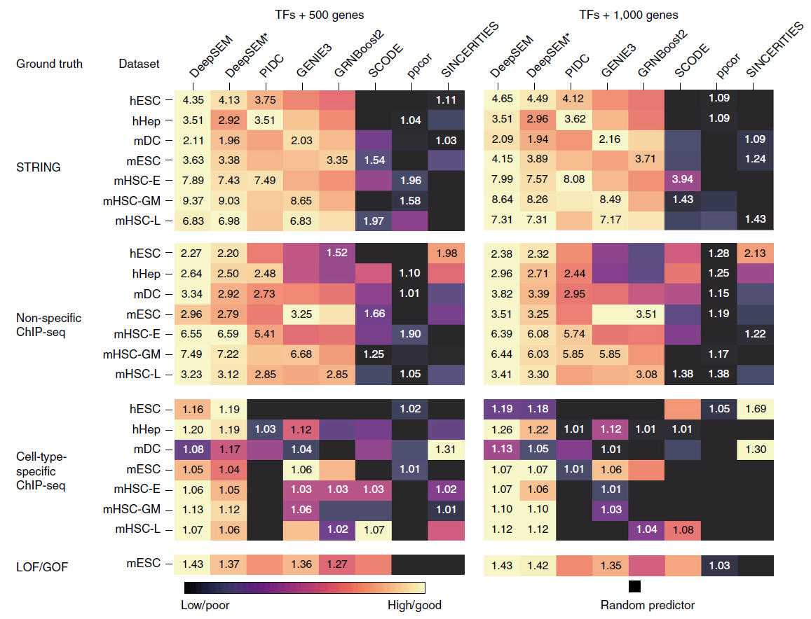
GRN Inference
Performance of GRN Inference
Metric: EPR (Early precision ratio)
Shu, H., Zhou, J., Lian, Q., Li, H., Zhao, D., Zeng, J., & Ma, J. (2021). Modeling gene regulatory networks using neural network architectures. Nature Computational Science, 1(7), 491-501.
Notes:
EPR: odds ratio of the true positives among the top K predicted edges between the model and the random predictions where K denotes the number of edges in ground-truth GRN

Slide 30
Single-cell Clustering and Embedding
Performance of Single-cell clustering and embedding
Shu, H., Zhou, J., Lian, Q., Li, H., Zhao, D., Zeng, J., & Ma, J. (2021). Modeling gene regulatory networks using neural network architectures. Nature Computational Science, 1(7), 491-501.

Slide 31
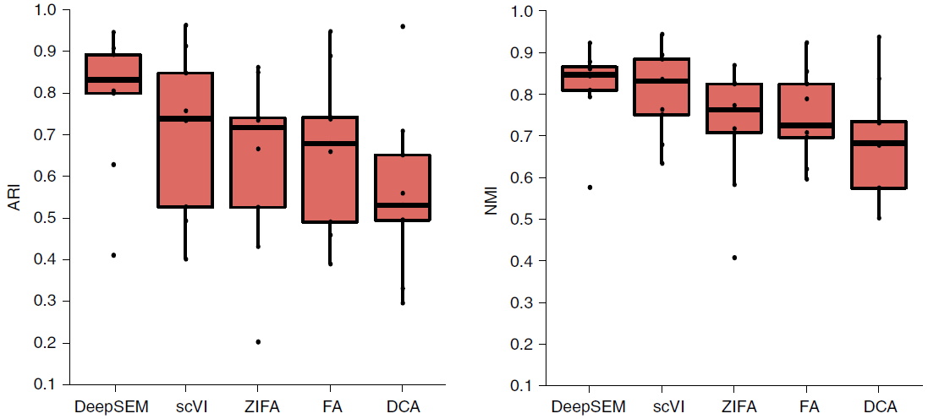
Single-cell Clustering and Embedding
Performance of Single-cell clustering and embedding
Shu, H., Zhou, J., Lian, Q., Li, H., Zhao, D., Zeng, J., & Ma, J. (2021). Modeling gene regulatory networks using neural network architectures. Nature Computational Science, 1(7), 491-501.
Notes:
The clustering performance of DeepSEM on nine single-cell datasets compared with four baseline methods
ARI: Adjusted Rand index 调和兰德指数
NMI: Normalized Mutual Information

Slide 32
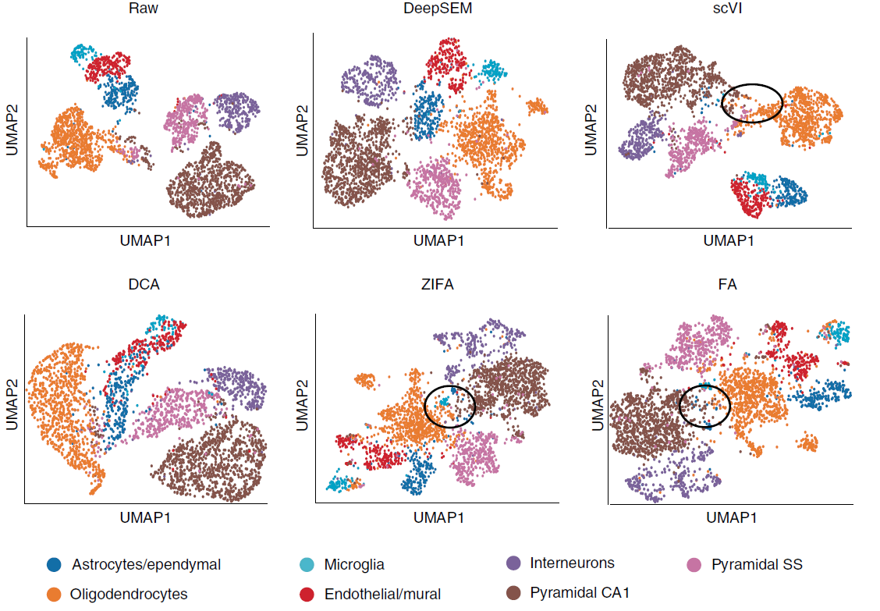
Single-cell Clustering and Embedding
Performance of Single-cell clustering and embedding
Shu, H., Zhou, J., Lian, Q., Li, H., Zhao, D., Zeng, J., & Ma, J. (2021). Modeling gene regulatory networks using neural network architectures. Nature Computational Science, 1(7), 491-501.
Notes:
UMAP visualization of hidden representations on the Zeisel dataset for different methods

Slide 33

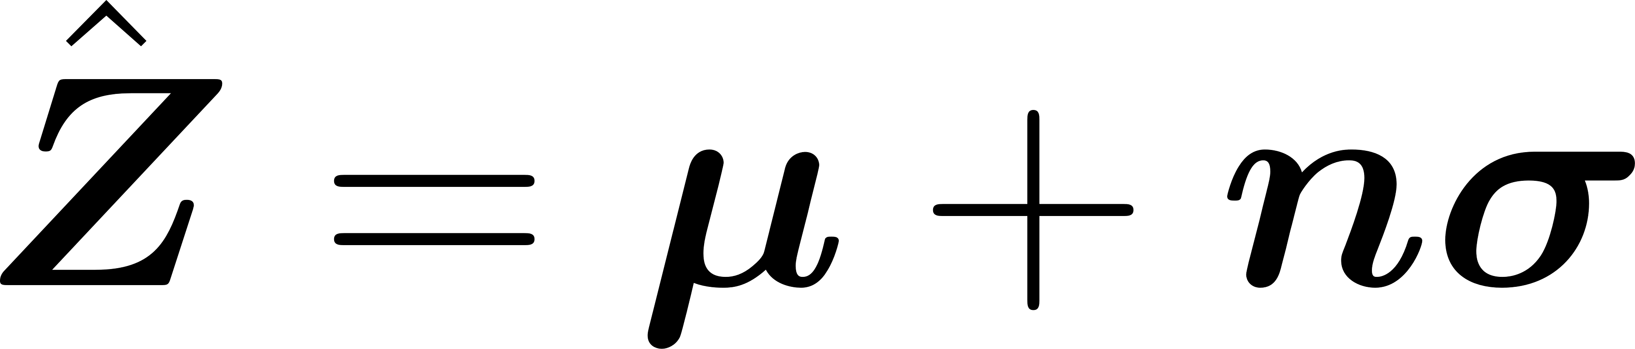
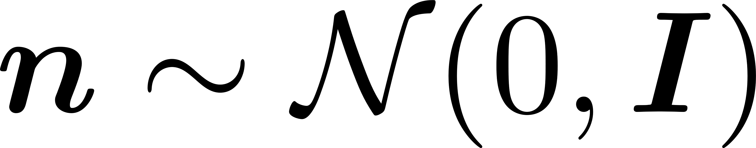
scRNA-seq Data Simulation
Simulation Performance
Perturb the hidden vector with Gaussian noise
Shu, H., Zhou, J., Lian, Q., Li, H., Zhao, D., Zeng, J., & Ma, J. (2021). Modeling gene regulatory networks using neural network architectures. Nature Computational Science, 1(7), 491-501.

Slide 34
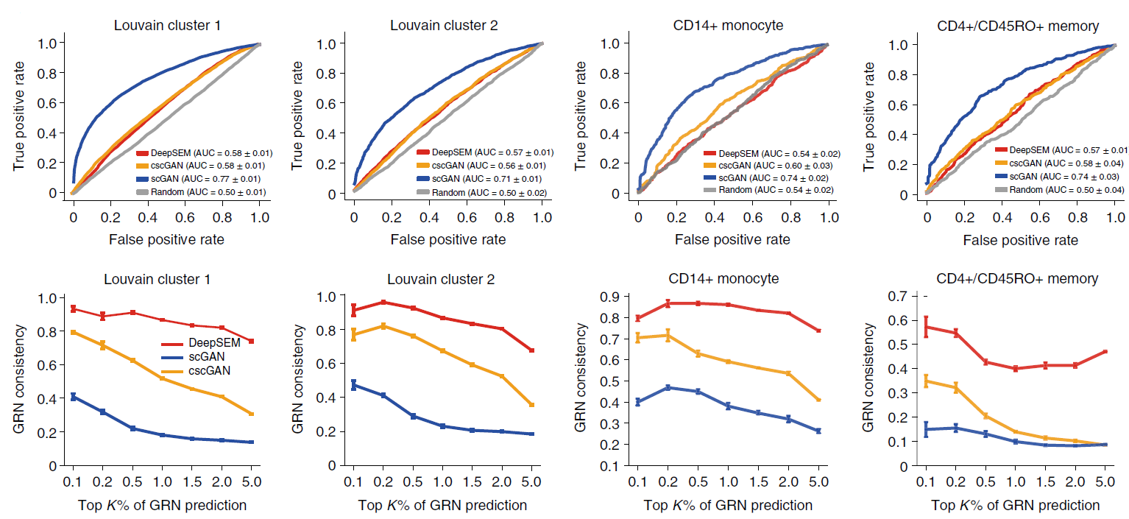
scRNA-seq Data Simulation
Simulation Performance
Shu, H., Zhou, J., Lian, Q., Li, H., Zhao, D., Zeng, J., & Ma, J. (2021). Modeling gene regulatory networks using neural network architectures. Nature Computational Science, 1(7), 491-501.
Notes:
AUROC曲线

Slide 35
scRNA-seq Data Simulation
Simulation Performance
Shu, H., Zhou, J., Lian, Q., Li, H., Zhao, D., Zeng, J., & Ma, J. (2021). Modeling gene regulatory networks using neural network architectures. Nature Computational Science, 1(7), 491-501.
Notes:
AUROC曲线

Slide 36
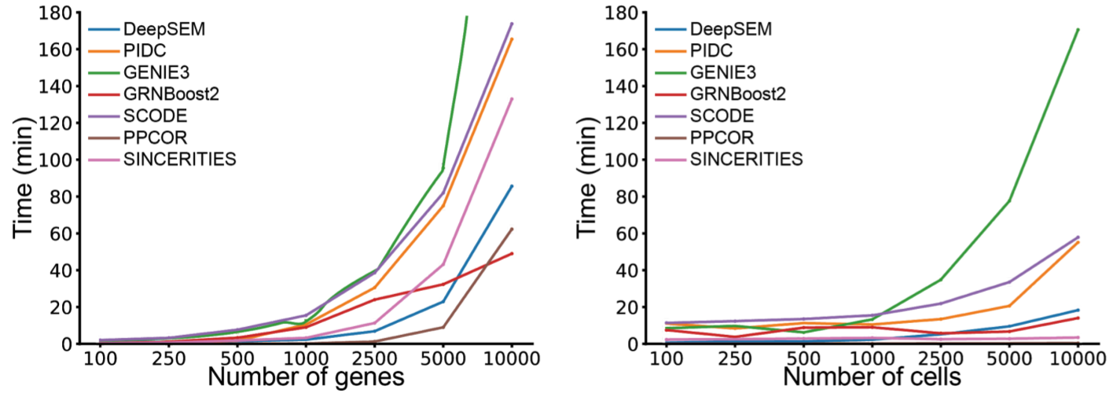
Discussion: Inspirations and Critics
Inspirations
Utilize deep neural networks for enhanced model capacity
One model for various single-cell computational tasks
Combination of deep learning and causal inference gives explainablility
Critics
The model need to be trained from scratch for each set of scRNA-seq data, and the training procedure is (notoriously) unstable, though the training speed is comparably acceptable
TFs are omitted in GRN, thus he predicted regulatory interactions are suspicious

Slide 37
Thank you
Yuzhe Wang¹, Shan Liu²
¹ Peking University
² Beijing Computational Science Research Center

